Slide 1
Introduction
For this topic we will be focussing on the following:
Using PHP to Create a Simple Login Form
Using PHP to Create a Simple Script to check the user’s Login details

Slide 2
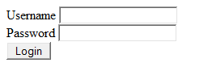
Creating a Simple Login Form – Part 1
You will need to create a Form that looks similar to this:

Slide 3
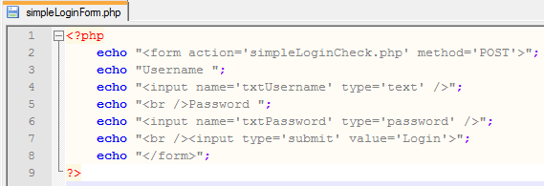
Creating a Simple Login Form – Part 2
Here is the PHP Script for simpleLoginForm.php:

Slide 4
Creating a Simple Script to check the user’s Login details – Part 1
Now that you have created and tested your Form it is now time to create the Script that will check the user’s login details
You will need to make sure that you check the following:
The username – It can be either correct or incorrect
The password – It can either be correct or incorrect
The script will only allow the user access if both the username and password are correct!

Slide 5
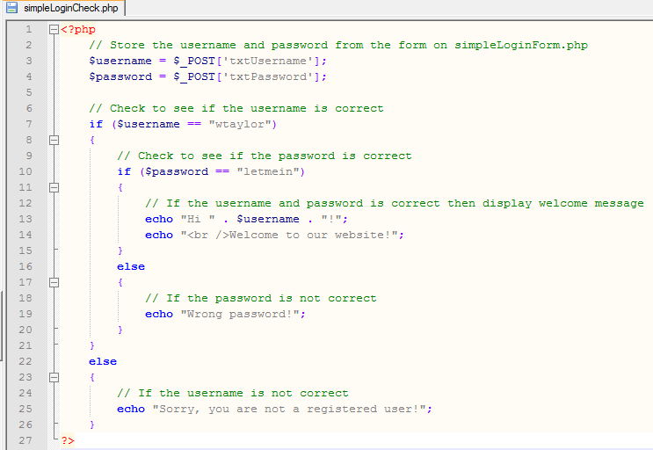
Creating a Simple Script to check the user’s Login details – Part 2
Here is the PHP Script for simpleLoginCheck.php:

Slide 6
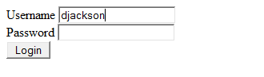
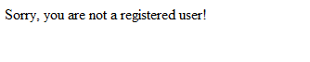
Creating a Simple Script to check the user’s Login details – Part 3
Test 1 – Use an incorrect Username:
Should display the following:

Slide 7
Exercises
1 – Creating a Simple Login Form
1a) Create, Upload and Test the simpleLoginForm .php Script
2 – Creating a Simple Script to check the user’s Login details
2a) Create and Upload the simpleLoginCheck.php Script (make sure that you use your own username and invent a password)
2b) Test it by using the following Tests to make sure the Script works fully:
Incorrect Username
Correct Username and Incorrect Password
Correct Username and Correct Password
3 – Change the Simple Script so that it can be used by 3 different Users

